Slide 1
Features of Pointers:
Pointers save memory space.
Execution time with pointers is faster because data are manipulated with the address, that is, direct access to
memory location.
Memory is accessed efficiently with the pointers. The pointer assigns and releases the memory as well. Hence it can be said the Memory of pointers is dynamically allocated.

Slide 2
Pointers are used with data structures. They are useful for representing two-dimensional and multi-dimensional
arrays.
An array, of any type can be accessed with the help of pointers, without considering its subscript range.
Pointers are used for file handling.
Pointers are used to allocate memory dynamically.

Slide 3
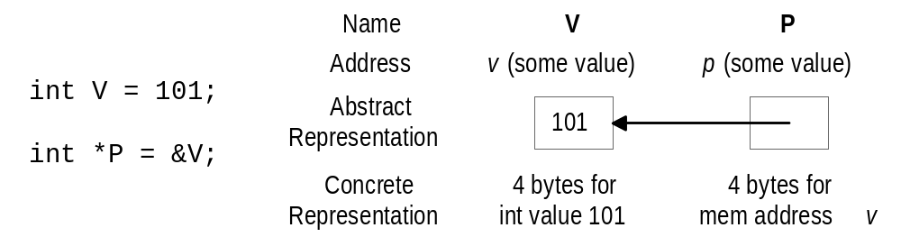
Pointer Basics
A pointer is a variable whose value is the address of another variable, i.e., direct address of the memory location.
A pointer variable contains a representation of an address of another variable (P is a pointer variable in the following):
Syntax: type *var-name;

Slide 4
Pointer Variable Definition
Basic syntax: Type *Name
Examples:
  int *P; /* P is var that can point to an int var */
  float *Q; /* Q is a float pointer */
  char *R; /* R is a char pointer */
Complex example:
  int *AP[5]; /* AP is an array of 5 pointers to ints */
  more on how to read complex declarations later

Slide 5
Address (&) Operator
The address (&) operator can be used in front of any variable object in C -- the result of the operation is the location in memory of the variable
Syntax: &VariableReference
Examples:
  int V;
  int *P;
  int A[5];
  &V - memory location of integer variable V
  &(A[2]) - memory location of array element 2 in array A
  &P - memory location of pointer variable P

Slide 6
Pointer Variable Initialization/Assignment
(a) We define a pointer variable,
(b) assign the address of a variable to a pointer and
(c) finally access the value at the address available in the pointer variable.
Examples:
  int V;
  int *P = &V;
  int A[5];
  P = &(A[2]);

Slide 7
Indirection (*) Operator
A pointer variable contains a memory address
To refer to the contents of the variable that the pointer points to, we use indirection operator
Syntax: *PointerVariable
Example:
  int V = 101;
  int *P = &V;
  /* Then *P would refer to the contents of the variable V (in this case, the integer 101) */
  printf(“%d”,*P); /* Prints 101 */

Slide 8
Pointer Sample
#include <stdio.h>
int main ()
  {
    int var = 20; /* actual variable declaration */
    int *ip; /* pointer variable declaration */
    ip = &var; /* store address of var in pointer variable*/
    printf("Address of var variable: %x\n", &var ); /* address stored in pointer variable */
    printf("Address stored in ip variable: %x\n", ip ); /* access the value using the pointer */
    printf("Value of *ip variable: %d\n", *ip );
    return 0;
  }

Slide 9
Pointer Sample
When the above code is compiled and executed, it produces the following result −
Address of var variable: bffd8b3c
Address stored in ip variable: bffd8b3c
Value of *ip variable: 20

Slide 10
NULL Pointers
It is always a good practice to assign a NULL value to a pointer variable in case you do not have an exact address to be assigned.
This is done at the time of variable declaration.
A pointer that is assigned NULL is called a null pointer.

Slide 11
NULL Pointers
#include <stdio.h>
int main ()
  {
    int *ptr = NULL;
    printf("The value of ptr is : %x\n", ptr );
    return 0;
  }
When the above code is compiled and executed, it produces the following result −
The value of ptr is 0

Slide 12
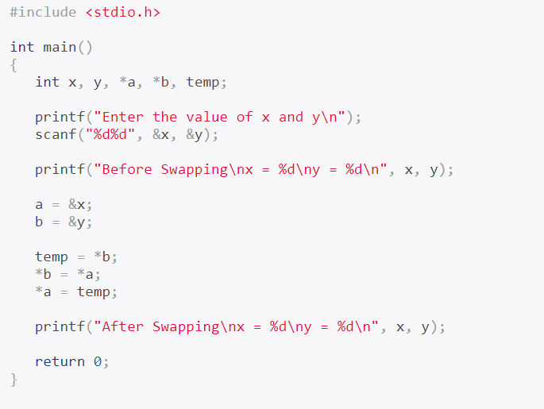
Swapping two number using pointer

Slide 13
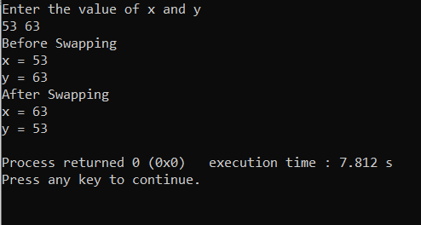
OUTPUT:

Slide 14
Pointers to Pointers
A pointer can also be made to point to a pointer variable (but the pointer must be of a type that allows it to point to a pointer)
Example:
  int V = 101;
  int *P = &V; /* P points to int V */
  int **Q = &P; /* Q points to int pointer P */
  printf(“%d %d %d\n”,V,*P,**Q); /* prints 101 3 times */

